Slide 1


Major Project NEXUS
Department of Computer Engineering
Guide: Prof. (Dr.) Sandip Shinde
Group Number: 18

Slide 2
Department of Computer Engineering
Name | Class | Roll Number | GR. Number
Aniruddha Kulkarni | CS-B | 10 | 11910240
Shreyas Habade | CS-B | 01 | 11910447
Niharika Rathi | CS-C | 09 | 11910555
Anushka Shinde | CS-D | 09 | 11910334

Slide 3
Outline
Content
Problem Statement
Project Objective
Domain
Literature Review
Technology
Tool
Timeline
Results
Conclusions
References

Slide 4
Content
Nexus
(A software authentication checker tool for computer networks)
Domain: Smart Systems, Computer Networks
Technology:
Python3,
REST API Development,
Shell Scripting,
Networking Fundamentals
Database Integration

Slide 5
Problem Statement
Users might sometimes install applications from untrustworthy sources which might unknowingly cause piracy.
Third party applications might not always comply with the prerequisites set by an operating system.
The proposed system hopes to monitor the devices on a network by keeping a track of authentic/un-authentic applications.

Slide 6
Project Objective
To create a novel system that on a network of computers keeps a track of all devices their details and any applications that might not comply with operating system standards.
The proposed system will:
Register users into the system
Help users to login to computers and push device data into an API hosted online
The system will also on windows and unix based systems keep a track of applications on basis of their authenticity.

Slide 7
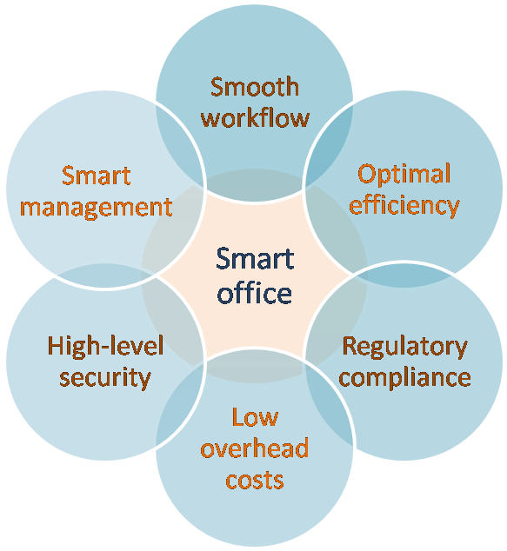
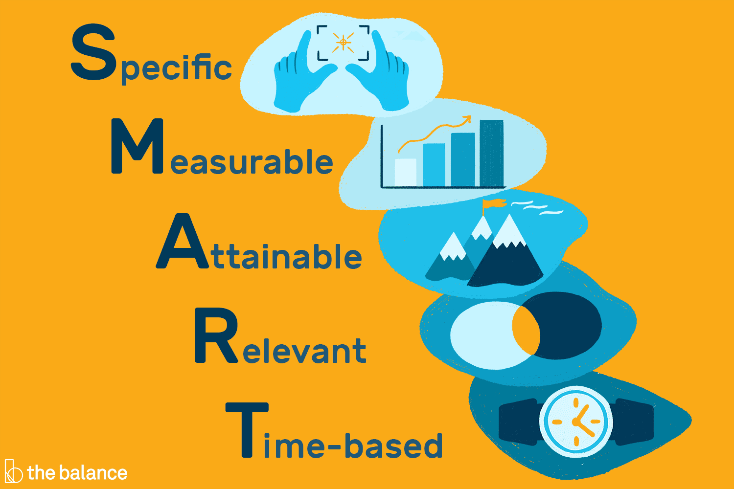
Domain
Smart Management Systems: The “SMART” in Smart Management systems refers to criteria for setting goals and objectives, namely that these goals are:
Specific, Measurable, Attainable, Relevant, and Time-bound.

Slide 8
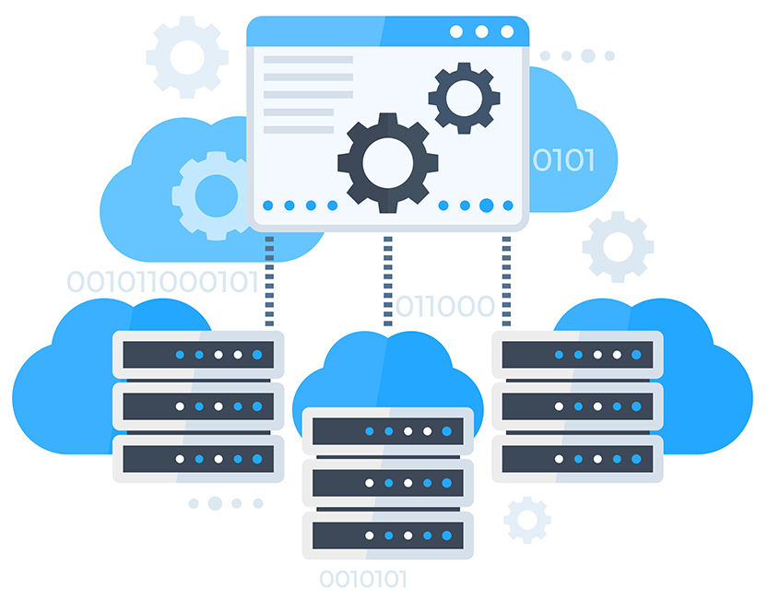
Domain
Network Management Systems: A network management system, or NMS, is an application or set of applications that lets network engineers manage a network's independent components inside a bigger network management framework and performs several key functions.

Slide 9
Literature review
In the thesis paper (Software Licensing Analysis Tool, Tomáš Radej, 2013 (link)), Tomáš Radej has explained about the problems faced for detection and scanning of open licenses.
In the research paper (Comparison of Open Source License Scanning Tools, Hailing Zhang (Link)), authors have provided insights for popular FOSS (Free and Open Source Software) license scanning tools.
In the paper (Automated software license analysis, Timo Tuunanen, Jussi Koskinen & Tommi Kärkkäinen, 2009 (link)), authors have described an automated approach for OSS(Open source software) license analysis.

Slide 10
Technology
Python3
Shell Scripting
REST API Development
API Hosting (GitHub → Heroku)
GUI Design & Development
Database Management

Slide 11
Timeline for Project Work
Progress Report
Before mid-semester examination | Project flow complete Technologies finalised API bridge flow with database connectivity ideated MAC/IP networking codes ready for deployment
Before end-semester examination | Project Deployment Project testing on various operating systems Project completion Documentation

Slide 12
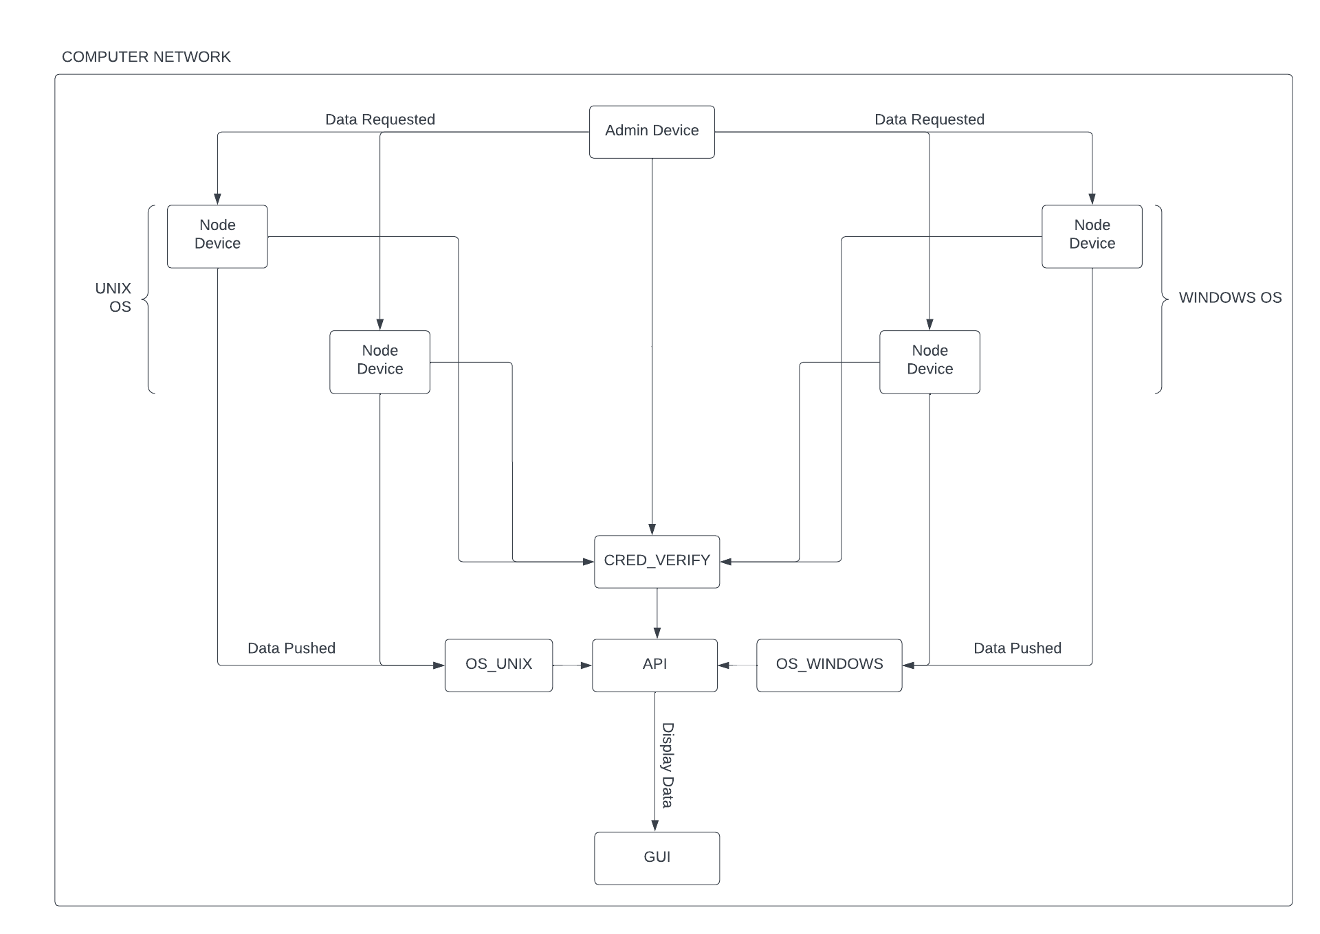
FlowChart
Flow for the system

Slide 13
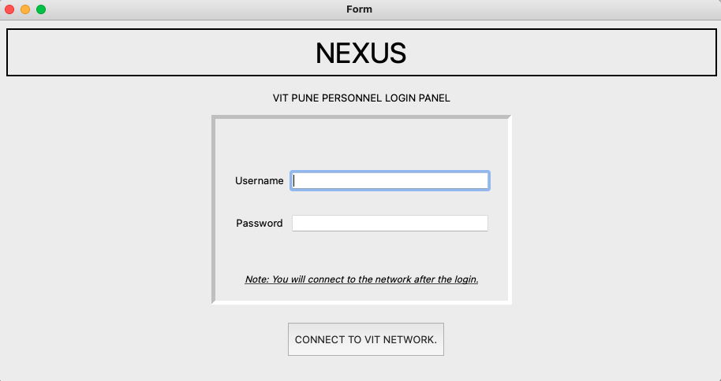
Results
Graphical User Interface created
GUI created using Python & PyQt5

Slide 14
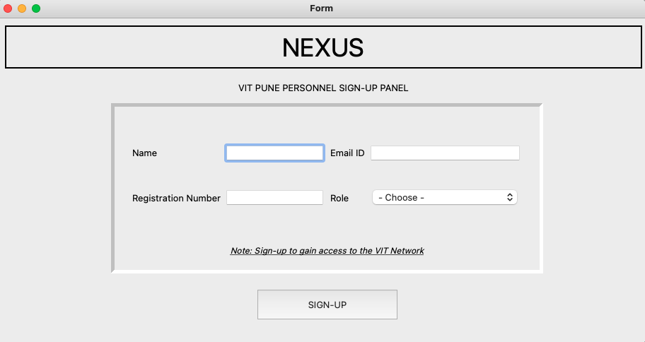
Results
Graphical User Interface created
GUI created using Python & PyQt5

Slide 15
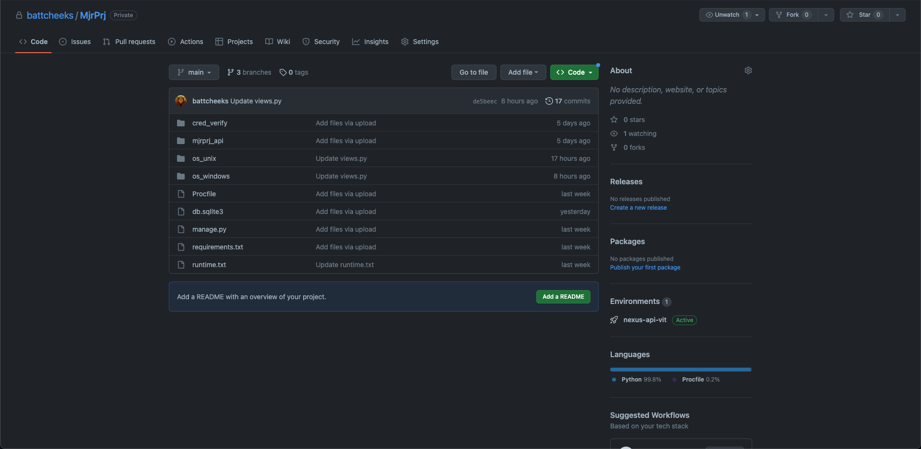
Results
API created using Django → GitHub → Heroku Pipeline
API Files stored on GitHub

Slide 16
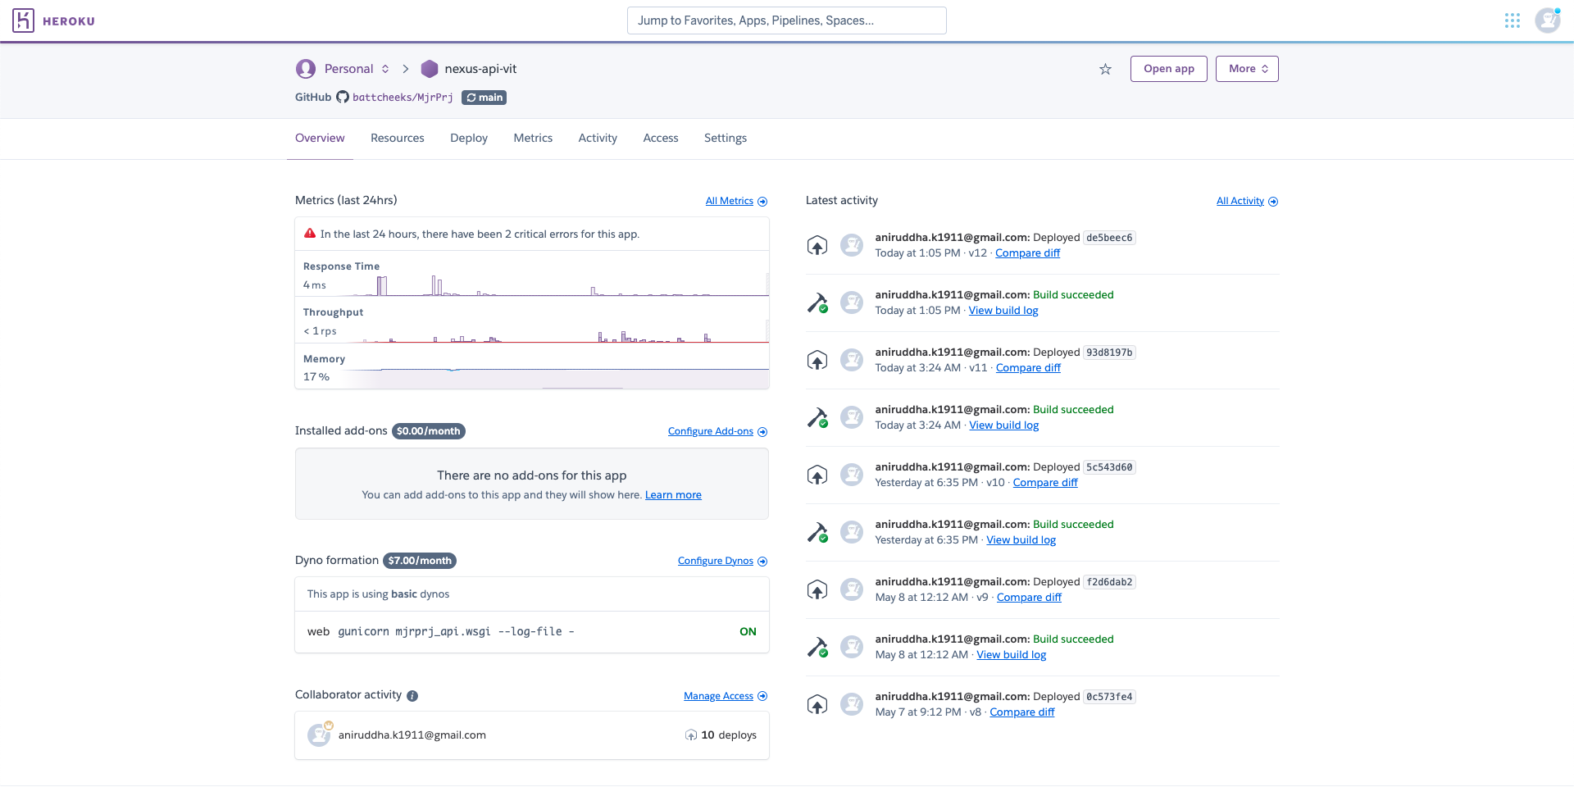
Results
API created using Django → GitHub → Heroku Pipeline
Heroku app connected to GitHub Repository

Slide 17
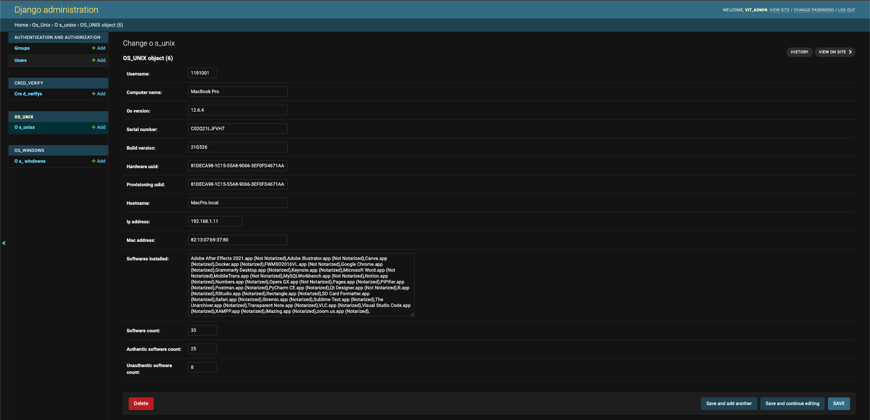
Results
API created using Django → GitHub → Heroku Pipeline
API Hosted Successfully
https://nexus-api-vit.herokuapp.com/

Slide 18
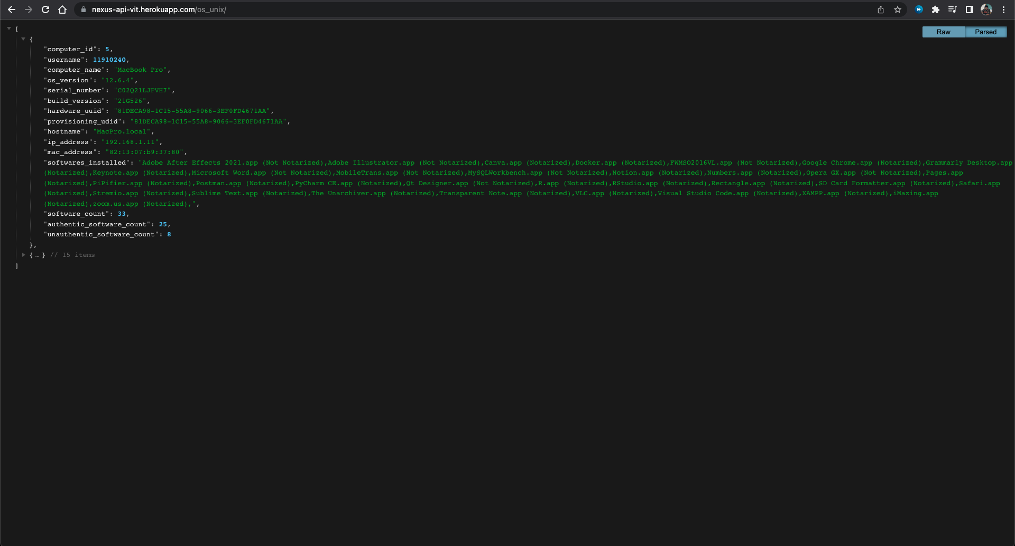
Results
API created using Django → GitHub → Heroku Pipeline
Data pushed into the API
https://nexus-api-vit.herokuapp.com/

Slide 19
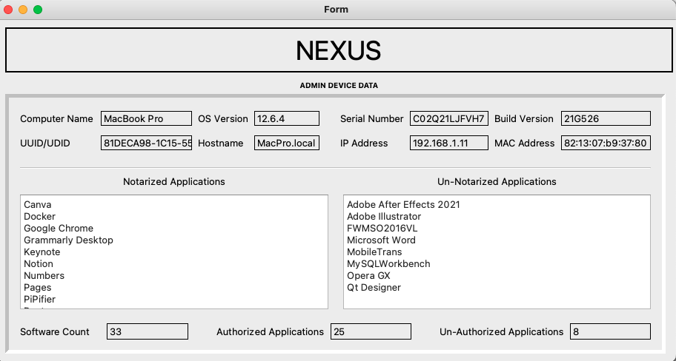
Results
Details fetched for a UNIX system
Fetched data for a UNIX System

Slide 20
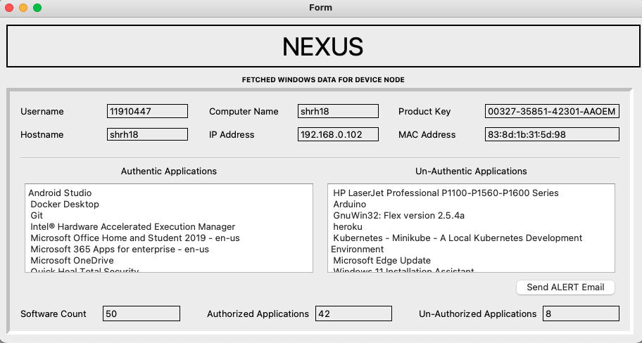
Results
Details fetched for a Windows system
Fetched data for a Windows System

Slide 21
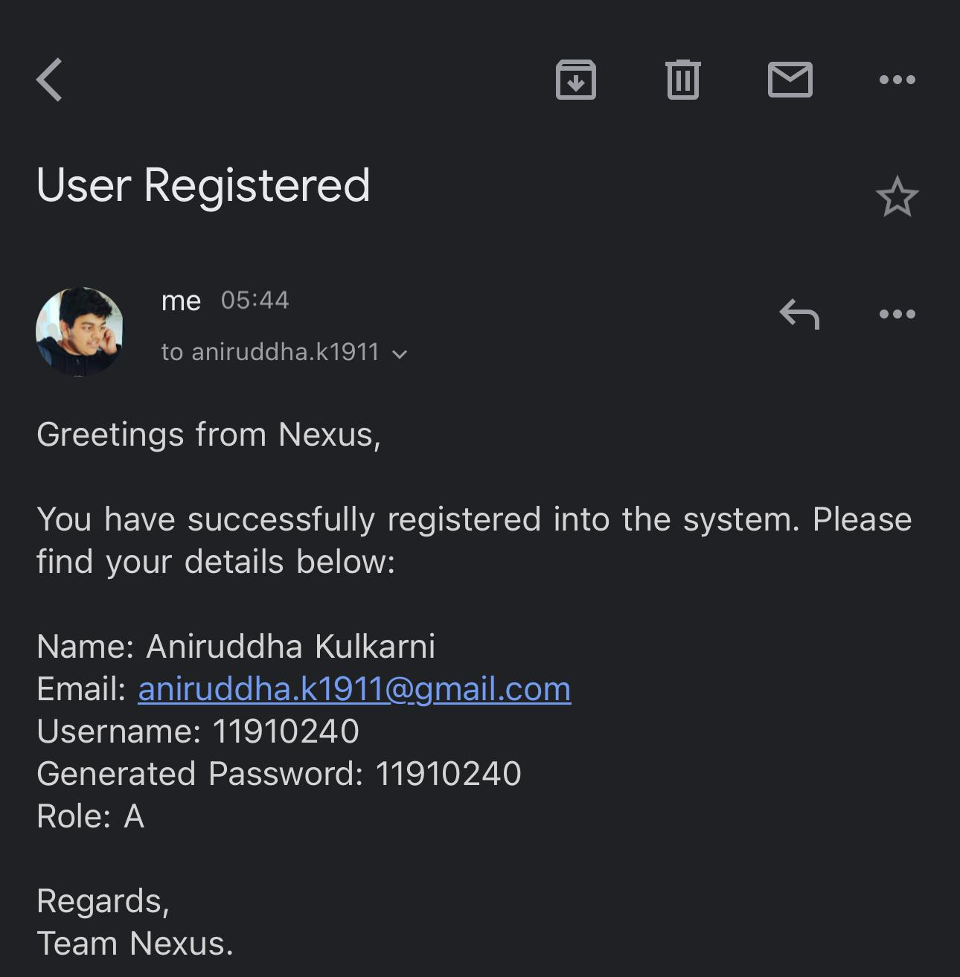
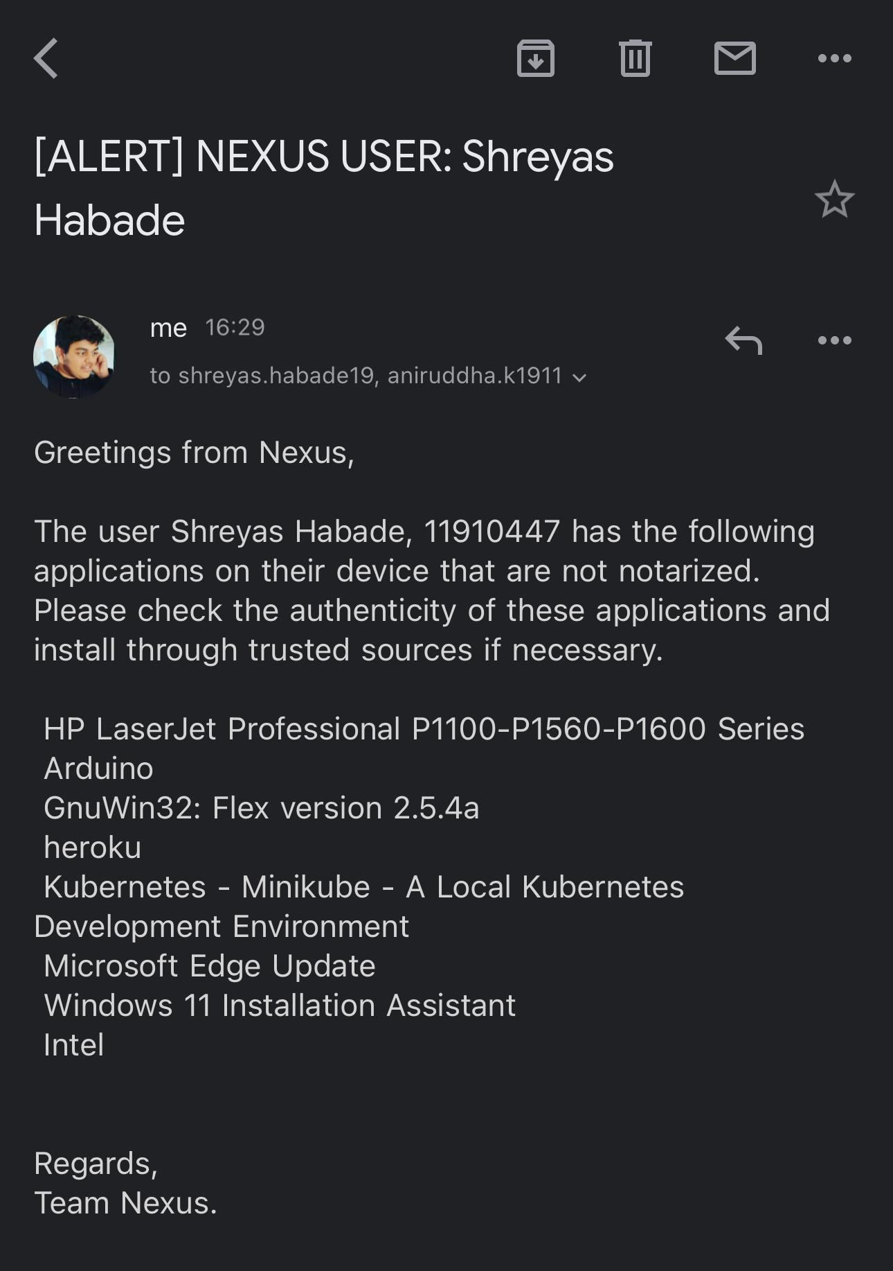
Results
Email Notification System set-up
Mail Notification Chain to Admin & Node Devices

Slide 22
References
Software Licensing Analysis Tool, Tomáš Radej, 2013 (link)
Comparison of Open Source License Scanning Tools, Hailing Zhang (Link)
Automated software license analysis, Timo Tuunanen, Jussi Koskinen & Tommi Kärkkäinen, 2009 (link)
https://www.geeksforgeeks.org/build-an-application-to-search-installed-application-using-python/
https://cryptolens.io/2019/01/python-code-for-software-licensing/

Slide 23
Thank You

